Slide 1

Introduction to Linux
Software Engineering

Slide 2
Contents
What is Linux?
Why use Linux?
Linux Distributions
History of Linux
Command Line & Basic Commands
Directory Structure

Slide 3

Linux?
Linux has been around since the mid-1990s and has since reached a user base that spans the globe. Linux is actually everywhere: It’s in your phones, your thermostats, in your cars, refrigerators, and televisions. It also runs most of the Internet, all of the world’s top 500 supercomputers, and the world’s stock exchanges.

Slide 4

What is LINUX?
Just like Windows, iOS, and Mac OS, Linux is an operating system. In fact, one of the most popular platforms on the planet, Android, is powered by the Linux operating system.
An operating system is software that manages all of the hardware resources associated with your desktop or laptop. To put it simply, the operating system manages the communication between your software and your hardware. Without the operating system (OS), the software wouldn’t function.

Slide 5

Why linux?
Linux is considered one of the most stable, secure, and reliable operating systems and is widely used in servers, supercomputers, and enterprise environments. Today, Linux is one of the most widely used operating systems in the world because it is open-source.
Check it OUT!: https://github.com/torvalds/linux

Slide 6
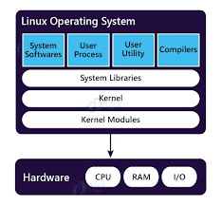
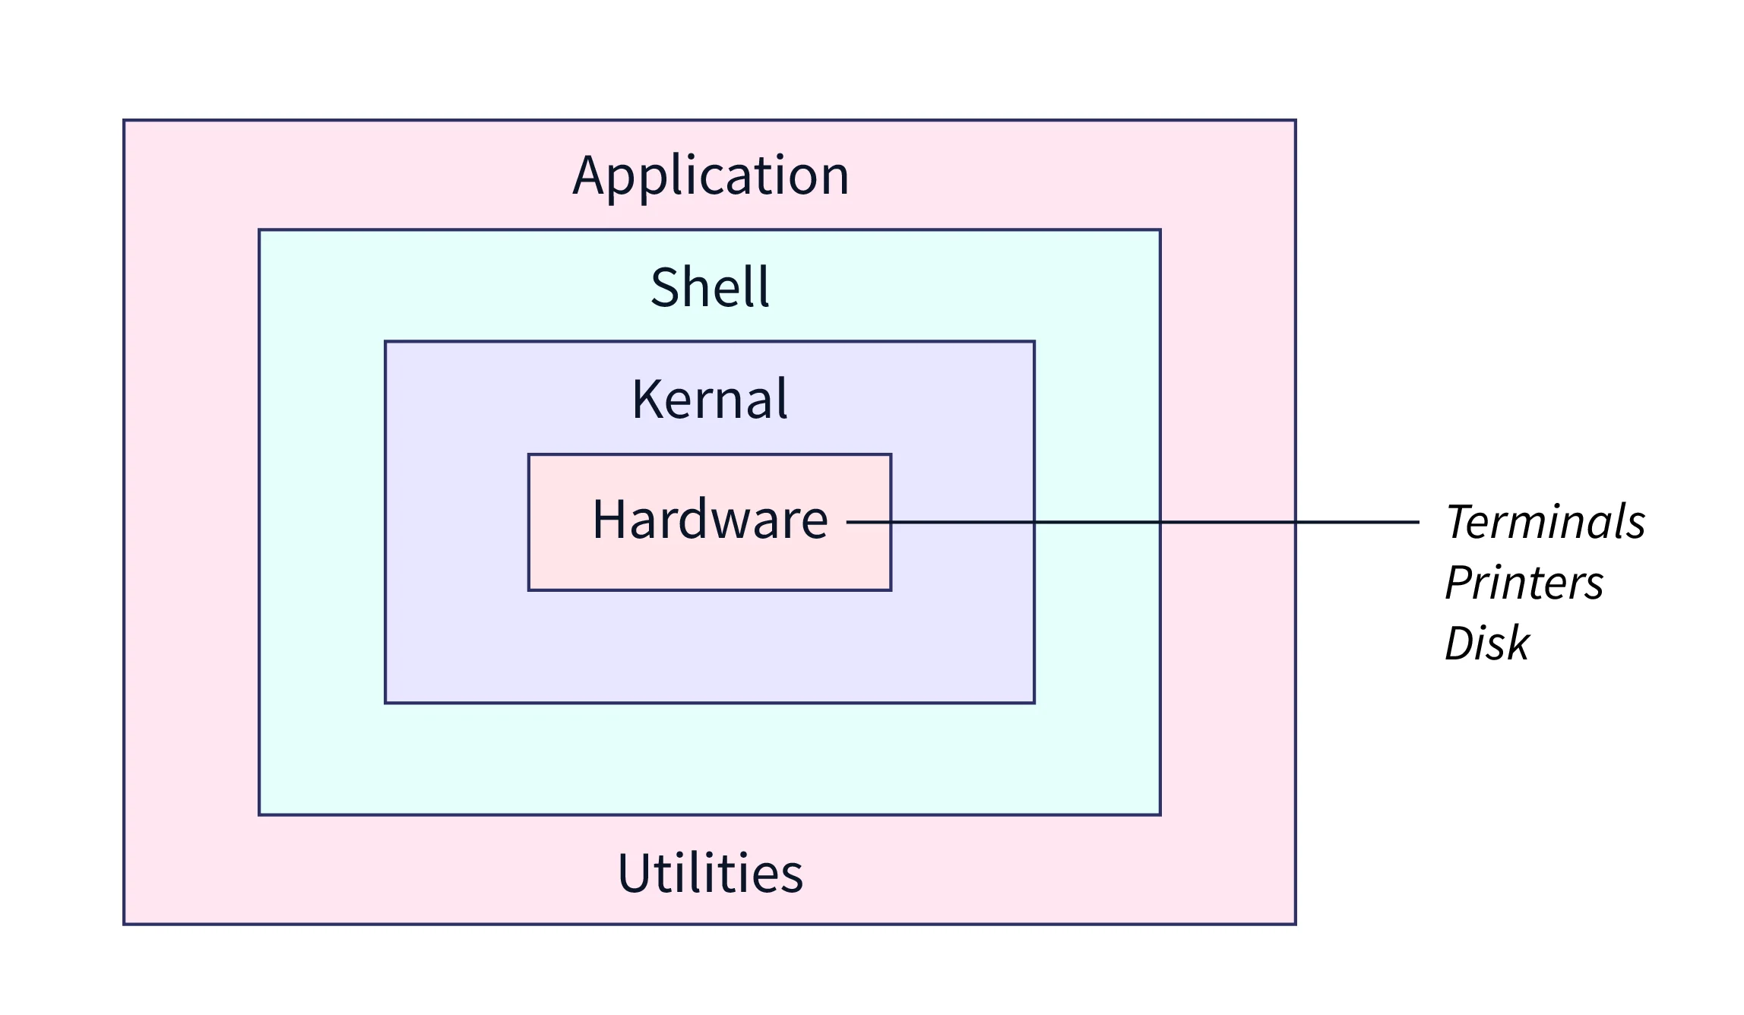
Linux os components

Slide 7
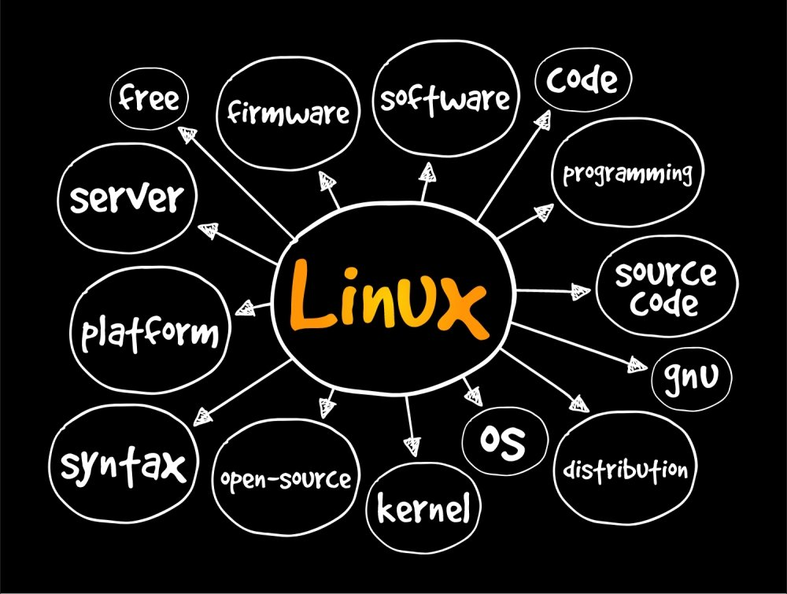
Linux is open source
The freedom to run the program, for any purpose.
The freedom to study how the program works, and change it to make it do what you wish.
The freedom to redistribute copies so you can help your neighbour.
The freedom to distribute copies of your modified versions to others.

Slide 8
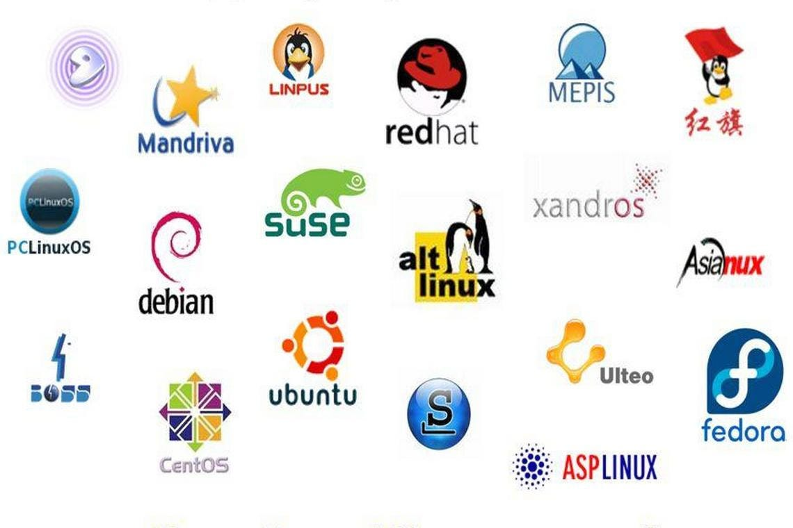
Linux distributions
Ubuntu
Fedora
Arch
Plasma
KDE
Mint
Manjaro

Slide 9
Linux distributions
Basic: Linux Mint, Ubuntu, Elementary OS or Deepin.
Above-average: Debian or Fedora
Challenging: Gentoo

Slide 10



History of linux
1970s: Unix development, Unix was developed as a multi-user, multi-tasking operating system and has been widely used in science and research.
1980s: Minix is ​​born, computer science professor Andrew S. Tanenbaum created a small Unix-like operating system called Minix.
1991: 21-year-old student named Linus Torvalds began working on a new operating system he named Linux.

Slide 11
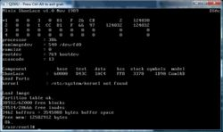

History of linux ctd
September 1991: Release of Linux 0.01: Linus released the first version of his Linux called Linux 0.01. It was a command-line operating system and was freely distributed on the Internet.
Linux community development: In the years that followed, Linux quickly gained popularity among programmers and enthusiasts.
Enterprise Adoption: In the late 1990s and early 2000s, the open-source nature of Linux made it more flexible, cost-effective, and more secure than proprietary operating systems such as Windows, making it a popular choice for enterprises and businesses.

Slide 12
Official Mascot of Linux
The official Linux mascot is a penguin named Tux. Created by artist Larry Ewing in 1996.
Tux was chosen as the mascot because the penguin is a rare animal found in the wild in Antarctica, just as Linux is a unique and powerful operating system. The name Tux comes from the short form “Torvalds Unix“, in honour of the creator of Linux, Linus Torvalds.

Slide 13
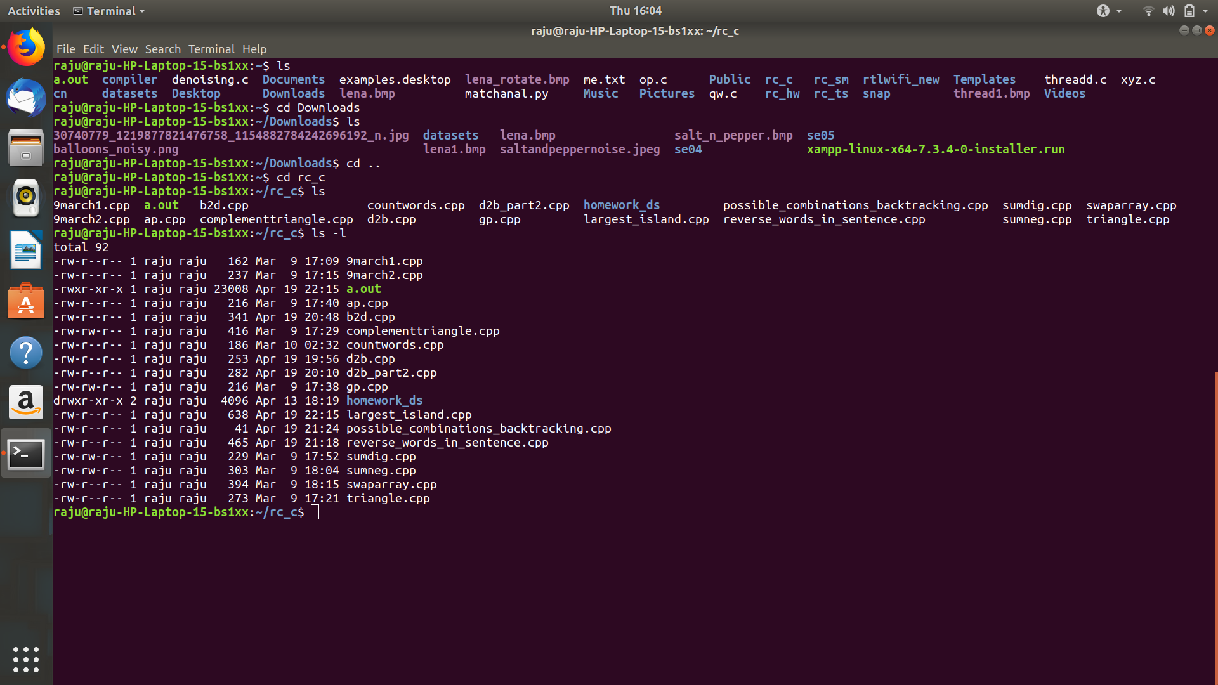
Linux command Line
The Linux command line is a text interface to your computer. Often referred to as the shell, terminal, console, prompt, or various other names.
Flexible to copy and paste commands
Shell is a program that manages the kernel that manages the drivers
Using the shell the user interfaces with the kernel
CTRL ALT T

Slide 14
Basic terminal commands
ls: Lists a directory’s content
cd: Changes the working directory
pwd: Shows the current working directory’s path
mkdir: Creates a new directory
rmdir: remove a directory

Slide 15
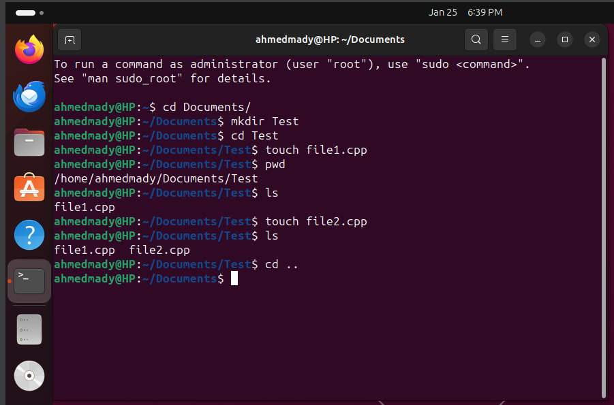
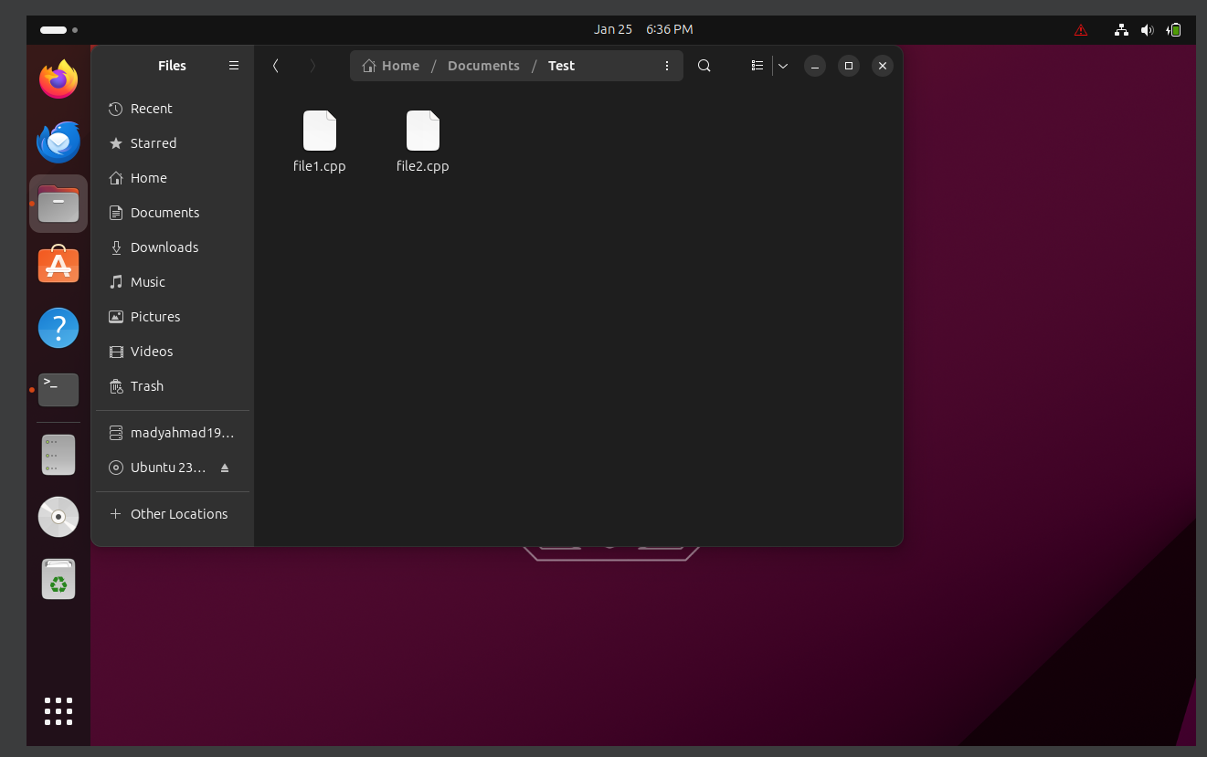
Example

Slide 16
Man keyword
The man command is a built-in manual for using Linux commands. It allows users to view the reference manuals of a command or utility run in the terminal. The man page (short for manual page) includes a command description, applicable options, flags, examples, and other informative sections.
man ls, man pwd, etc…
Press Q to exit the manual

Slide 17
cd
cd .. : Jumps 1 directory back
cd ~ : goes to the home directory

Slide 18
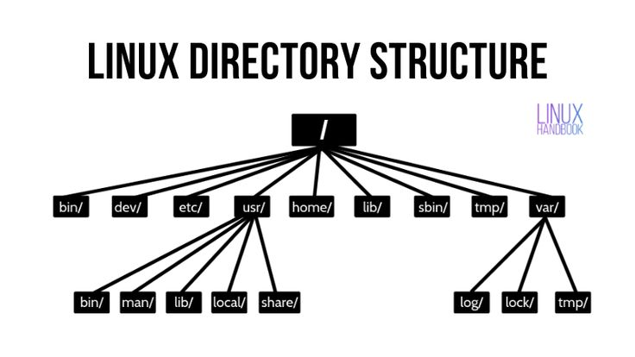
Directory Structure in Linux (TREE)
General Files – It is also called ordinary files. It may be an image, video, program, or simple text file. These types of files can be in ASCII or Binary format. It is the most commonly used file in the Linux system.
Directory Files –It may be a directory file within a directory (subdirectory).
Device Files – In a Windows-like operating system, devices like CD-ROM, and hard drives are represented as drive letters like F: G: H whereas in the Linux system devices are represented as files. As for example, /dev/sda1, /dev/sda2, and so on.

Slide 19
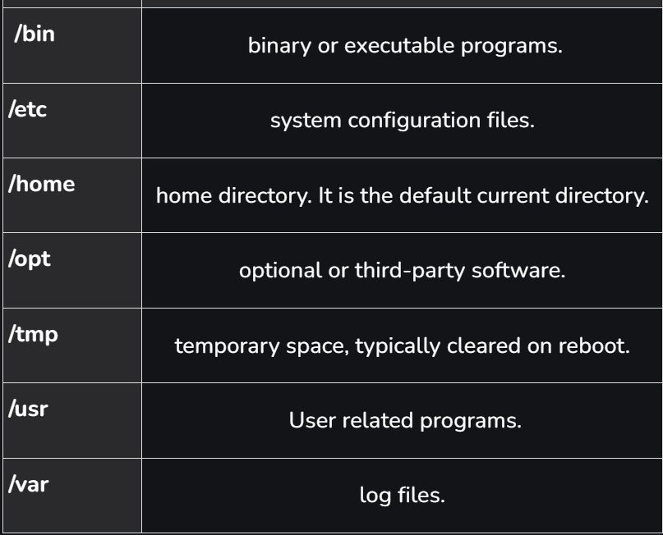
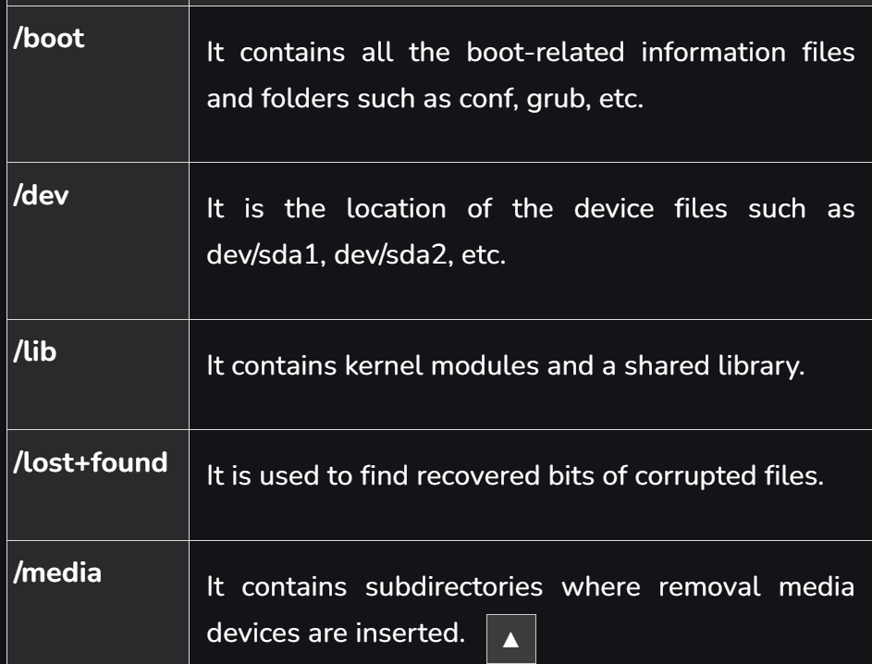
Directory Structure in Linux
libraries

Slide 20
/etc: contains the core configuration files of the system, use primarily by the administrator and services, such as the password file and networking files.
/usr: source of most of the system programs

Slide 21
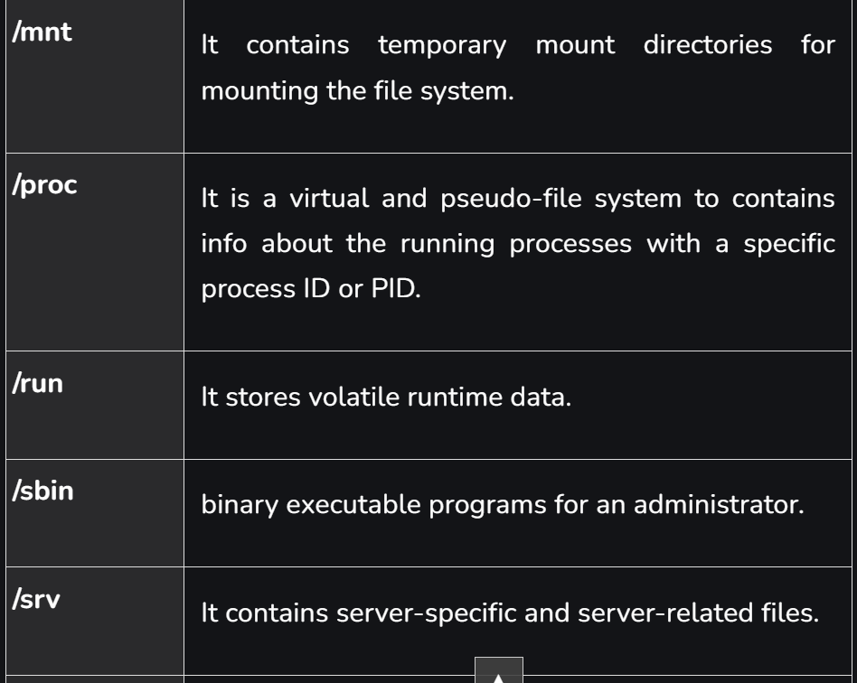
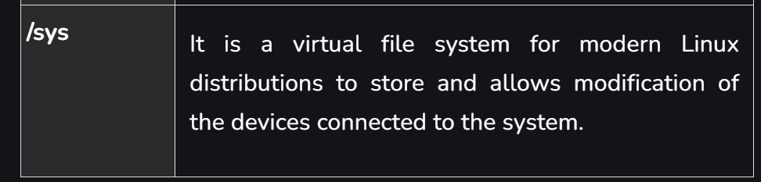

Slide 22
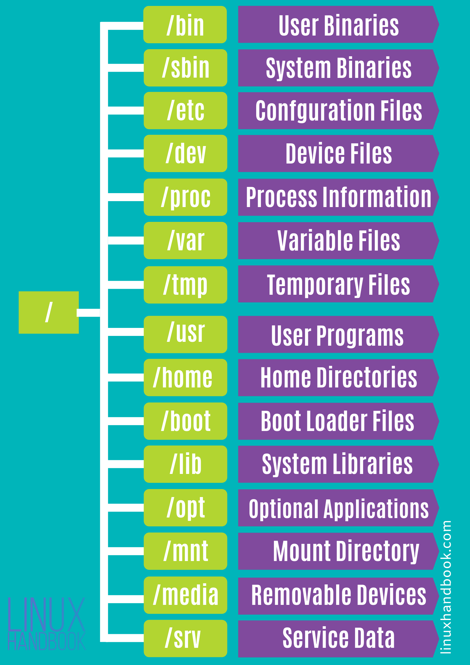

Slide 23
ls
-l Lists files and directories in long format, providing detailed information (permissions, owner, size, modification date).
-a Includes hidden files and directories in the listing (those starting with a dot).
-h Displays file sizes in a human-readable format (kilobytes, megabytes, gigabytes).
-t Sort files and directories by their last modification time, displaying the most recently modified ones first.
-r Reverses the order of the listing, displaying items in reverse alphabetical or chronological order.
-S Sort files and directories by their sizes, listing the largest ones first.

Slide 24
Resources
https://www.linux.com/what-is-linux/
https://www.geeksforgeeks.org/linux-history/
https://ubuntu.com/tutorials/command-line-for-beginners#1-overview
https://www.hostinger.com/tutorials/linux-commands
https://contabo.com/blog/linux-navigation-and-file-management/

